Slide 1
Introduction to Parallel Programming using CUDA
T. Ranjit
14.02.25

Slide 2
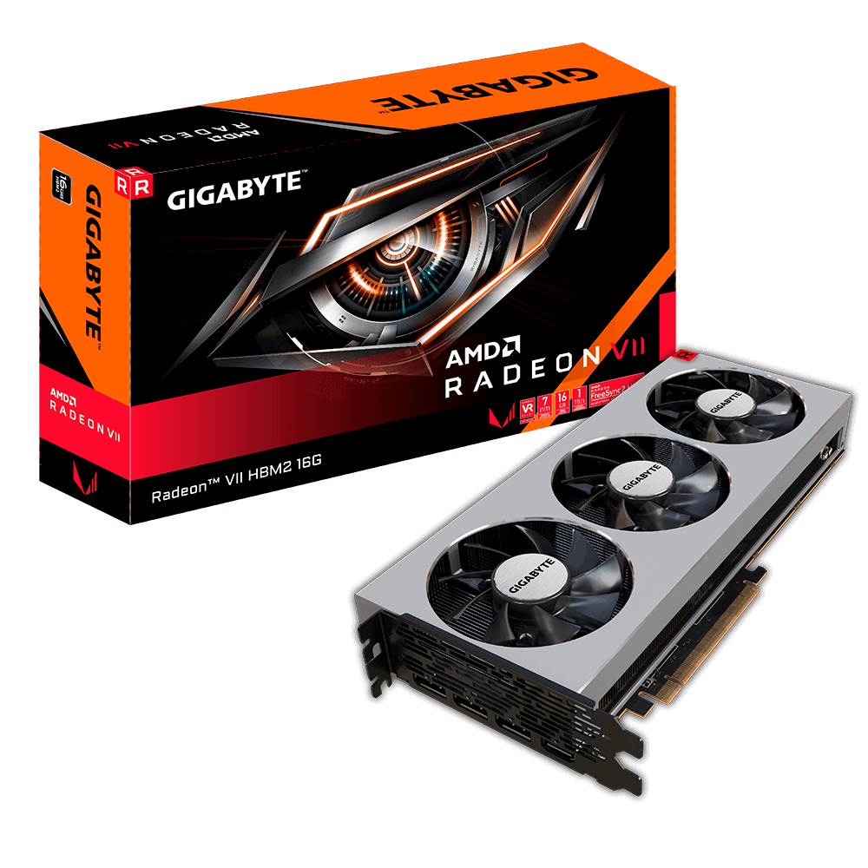
What is a GPU Exactly?

Slide 3
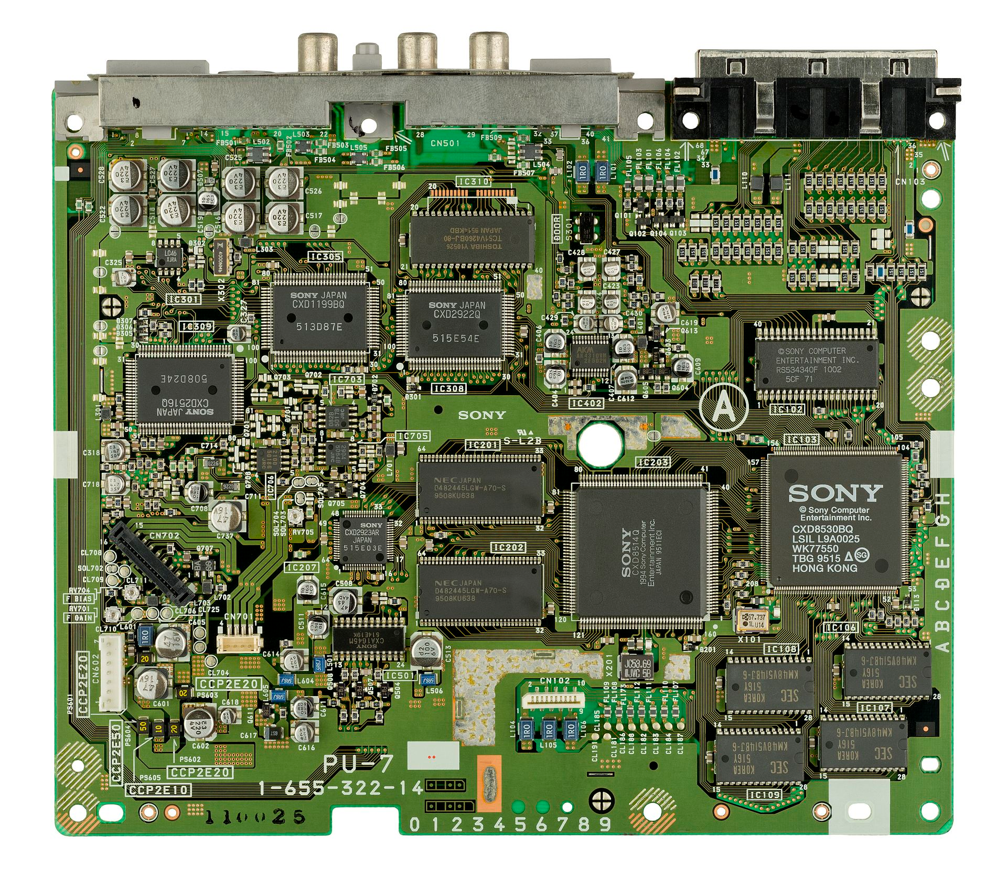
What is a GPU?
A graphics processing unit (GPU) is a specialized electronic circuit designed to rapidly render graphics and images by performing parallel mathematical calculations. Originally developed for computer graphics and image processing, GPUs have evolved to handle a wider range of applications.
The term "GPU" was coined by Sony in reference to the 32-bit Sony GPU (designed by Toshiba) in the PlayStation video game console, released in 1994.
Notes:
Historical context: From graphics acceleration to general-purpose computing:
GPUs were introduced in the 1990s to offload graphics-related tasks from CPUs1. In the early 2000s, researchers discovered GPUs' potential for general computing, leading to the development of CUDA by NVIDIA in 2007, which expanded GPU capabilities beyond graphics rendering

Slide 4
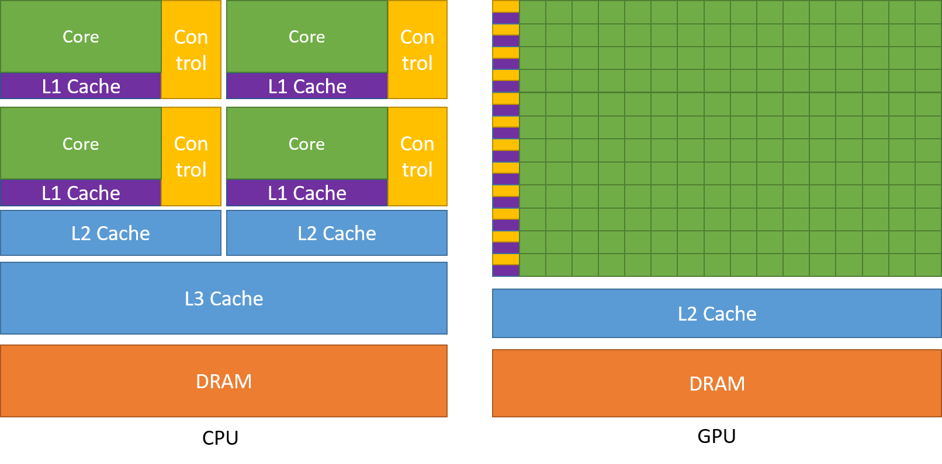
What makes a GPU different from a CPU
GPUs are composed of hundreds of cores that can handle thousands of threads simultaneously, while CPUs have just a few cores optimized for serial processing.
GPUs also higher compute density when compared to a traditional CPU.
This architectural difference allows GPUs to excel at parallel processing tasks

Slide 5
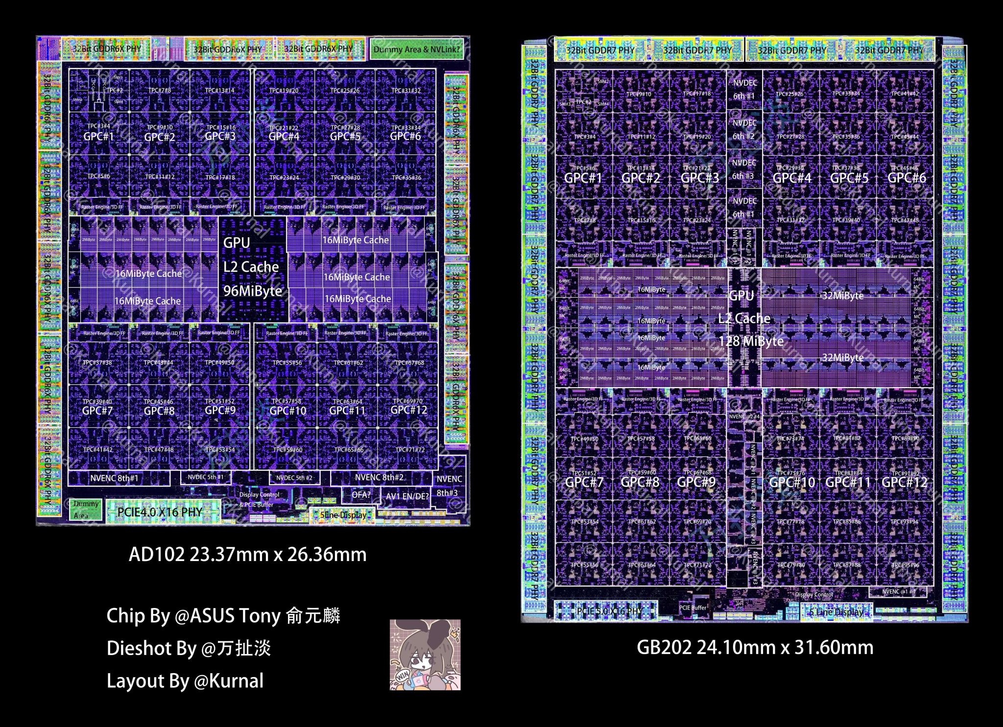
RTX 5090 DIE
92 Billion Transistors!!!
Notes:
https://x.com/Kurnalsalts/status/1883153126011892140/photo/1

Slide 6
2. What is Parallel Programming?

Slide 7
What is Parallel Programming?
Parallel programming is the process of breaking down a computational problem into smaller tasks that can be executed simultaneously using multiple compute resources. It allows a computer to use multiple processors or cores to solve problems concurrently, improving efficiency and speed.

Slide 8
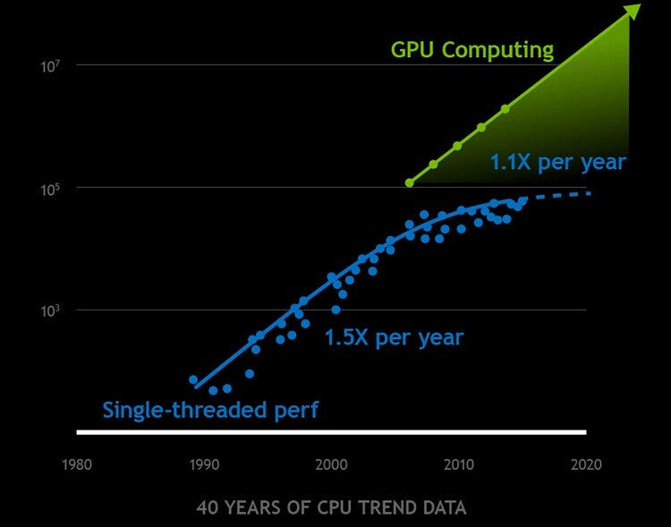
But why?
One answer: Moore’s Law

Slide 9
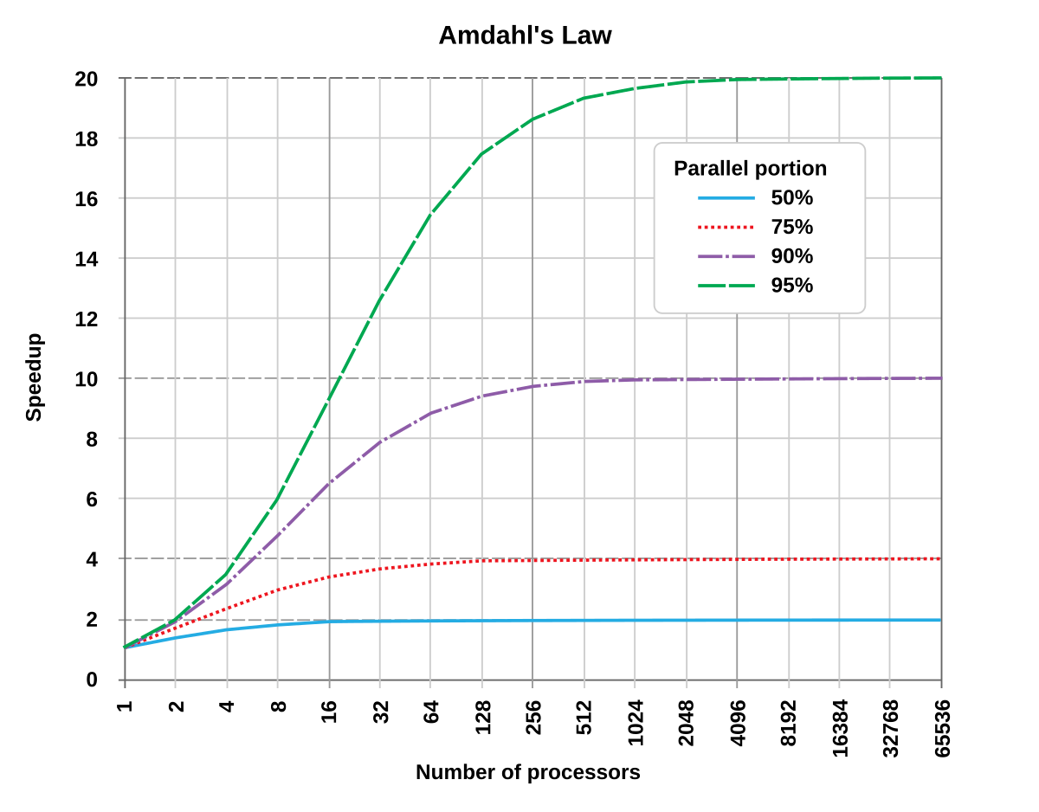
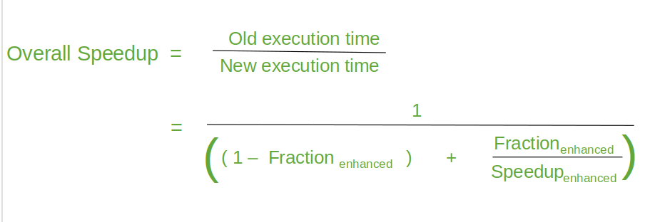
Amdahl’s Law
"the overall performance improvement gained by optimizing a single part of a system is limited by the fraction of time that the improved part is actually used"

Slide 10
3. What is CUDA?

Slide 11
What is CUDA?
CUDA (Compute Unified Device Architecture) is a parallel computing platform and programming model developed by NVIDIA in 2006. It allows software developers to use NVIDIA GPUs for general-purpose processing, enabling significant speedups for computationally intensive tasks.
Key features of CUDA include:
Direct access to the GPU's virtual instruction set and parallel computational elements
Support for programming languages like C, C++, Fortran, and Python
A software environment that includes libraries, debugging tools, and a runtime library
Ability to dramatically accelerate computing applications by leveraging GPU power
Notes:
Talk about requirements.

Slide 12
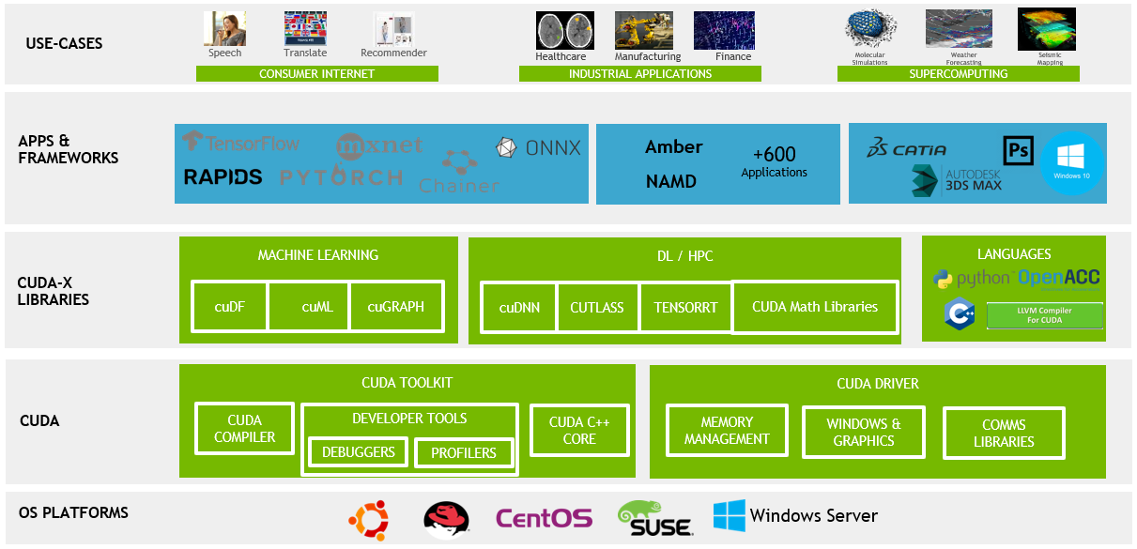
What is CUDA

Slide 13
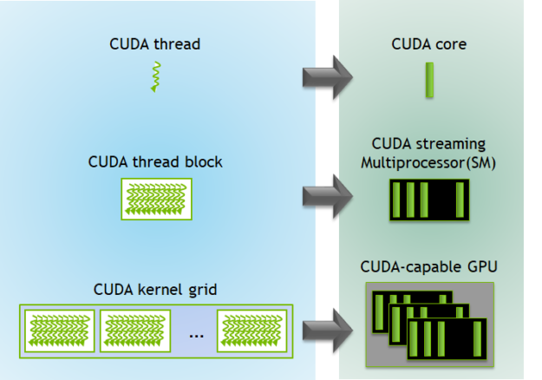
Threads, Blocks and Grids
The basic unit of parallel execution in CUDA. Each thread runs the same kernel function independently.
Threads are organized into groups called blocks. Number of threads per block can be defined by the user. A group of threads that can cooperate and share memory.
Notes:
SM is akin to the core of a CPU

Slide 14
Threads, Blocks and Grids
Each thread is assigned to a SM and cannot migrate. Each SM has 128 cuda cores, therefore, at any time 128 threads can run in parallel per block. So what if you have more threadblocks than fit on the SMs (as is frequently the case). They won't all run simultaneously. When a thread block completes the hardware will put on that's ready to execute onto the SM where the completed one was running.

Slide 15
Threads, Blocks and Grids
Grids in CUDA are an essential part of the thread hierarchy, organizing blocks of threads for parallel execution on GPUs. They are essentially a superset of all the Thread Blocks. They allow you to scale your program to fit any GPU.
All threads in a grid have access to the same global memory.

Slide 16
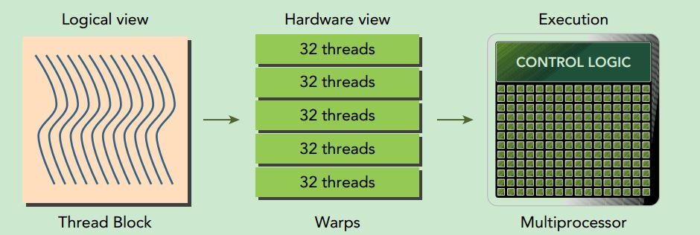
Warps
A Warp is a group of 32 threads that execute instructions simultaneously. All threads in a warp execute the same instruction at the same time, following the SIMD (Single Instruction, Multiple Data) model. Each SM has a specific number of CUDA cores, allowing multiple warps to run simultaneously. For example, an SM with 128 CUDA cores can run 4 warps simultaneously.

Slide 17
4. Programming in CUDA

Slide 18
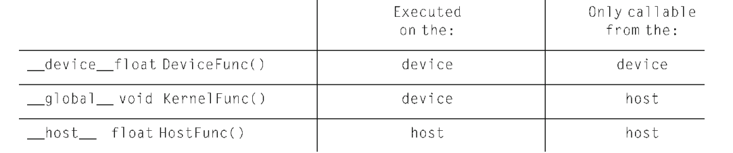
Kernel functions: global, device and host functions
Kernel functions: global, device, host keywords:
global: Defines a kernel function that runs on the GPU and is callable from the CPU
device: Defines a function that runs on the GPU and is only callable from the GPU
host: Defines a function that runs on the CPU (default for functions)
Notes:
CUDA extends C++ by allowing programmers to define special functions called kernels that can be executed in parallel on the GPU. These extensions include new keywords, built-in variables, and a syntax for launching kernels.

Slide 19
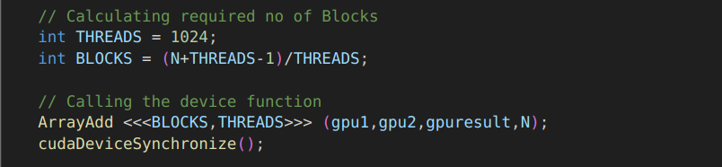
Function call example code

Slide 20
Code Example: ArrayAdd
Example located at
../Examples/ArrayAdd.cu

Slide 21
Code Example: Matrix Multiplication
Example located at
../Examples/MatrixMul.cu

Slide 22
Code Example: Parallel Reductions and Race conditions
Example located at
../Examples/ParallelReduction.cu

Slide 23
5. Memory Management in CUDA

Slide 24
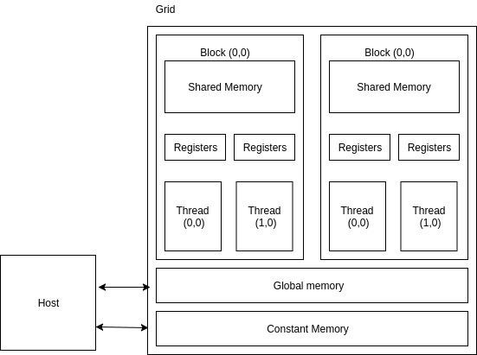
Memory in Cuda

Slide 25
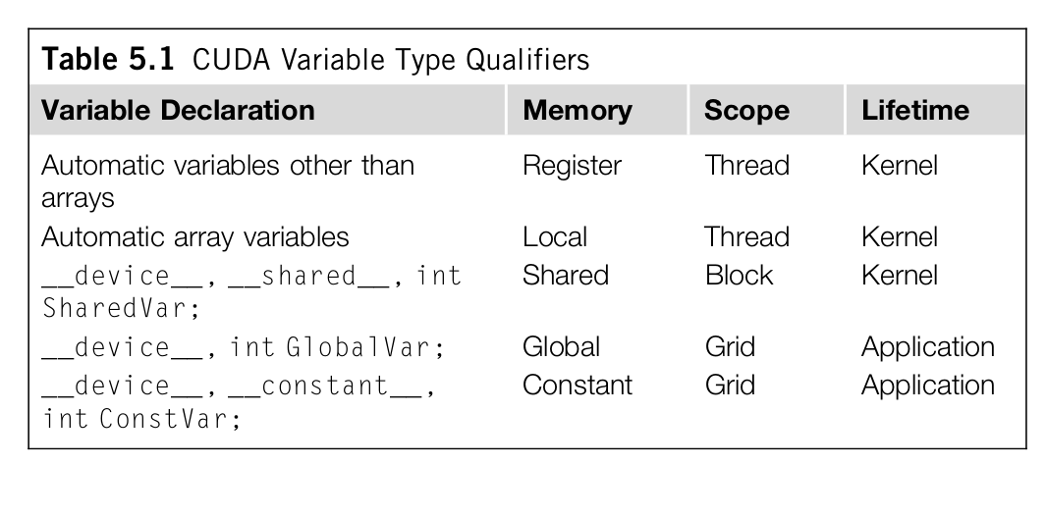
Variables in CUDA

Slide 26
cudaMalloc()
This function allocates memory on the GPU device.
cudaError_t cudaMalloc(void** pointer, int bytes)
It takes two parameters:
A pointer to a pointer where the allocated memory address will be stored
The number of bytes to allocate
cudaMalloc() creates memory on the GPU and returns a handle to it in the provided pointer

Slide 27
cudaMemcpy()
This function copies data between host and device memory.
cudaError_t cudaMemcpy(void* destination, void* source, int bytes, cudaMemcpyKind kind)
It takes four parameters:
Destination pointer
Source pointer
Number of bytes to copy
Direction of the copy (e.g., cudaMemcpyHostToDevice or cudaMemcpyDeviceToHost)

Slide 28
6. Limitations and Alternatives

Slide 29
Limitations
Memory constraints: GPUs have limited memory compared to CPUs, which can be problematic for large datasets.
Hardware dependency: CUDA only works on NVIDIA GPUs, limiting its portability.
Programming complexity: CUDA requires a steep learning curve and specific programming approaches, making it challenging for developers new to GPU computing.
Limited exception handling: While exceptions can be thrown on the device, try-catch blocks cannot be used, and backtrace printing is costly.
Data transfer bottlenecks: Moving data between CPU and GPU memory can be slow, impacting overall performance.

Slide 30
Alternatives: CPU Parallelism
OpenMP:
- Shared-memory parallelism
- Uses compiler directives (pragmas)
- Fork-join model
- Easier to implement
- Limited to single multi-core system
MPI:
- Distributed-memory parallelism
- Message passing between processes
- Explicit communication programming
- More complex, but highly scalable
- Can run across multiple networked computers
Notes:
Key Differences:
- Memory model: Shared vs. Distributed
- Scalability: Single system vs. Multiple systems
- Programming complexity: Simpler vs. More explicit
- Use cases: Single machine vs. Large-scale computing
Note: Can be combined for hybrid parallel programming

Slide 31
Alternatives: OpenCL
OpenCL (Open Computing Language) is a framework for writing parallel programs that can execute across heterogeneous computing platforms, including CPUs, GPUs, DSPs, and FPGAs. It provides a standard interface for parallel computing using both task-based and data-based parallelism.
It is an open-source framework that was developed by collaboration between industry behemoths like Apple, AMD, Intel, IBM, Qualcomm and Nvidia.
CUDA often provides better performance on NVIDIA GPUs due to its closer integration with the hardware architecture.
CUDA also has a more established ecosystem with comprehensive tools and libraries specifically for NVIDIA GPUs, while OpenCL's ecosystem is broader but may not be as specialized.

Slide 32
Alternatives: ROCm
AMD’s open source alternative to CUDA.
Open source but only runs on AMD.
Launched in 2016.
Currently integrated into a few libraries like pyTorch and Tensorflow, but hasn’t gained much traction due to the rarity of AMD GPUs in the B2B sector. However, it is slowly gaining popularity now along with AMD GPUs

Slide 33
7. Resources

Slide 34
Resources
Programming Massively Parallel Processors: A Hands-on Approach by David Kirk and Wen-mei Hwu
(Book Included in Repo)
https://youtube.com/playlist?list=PLC6u37oFvF40BAm7gwVP7uDdzmW83yHPe&feature=shared
https://www.youtube.com/playlist?list=PLU0zjpa44nPXddA_hWV1U8oO7AevFgXnT

Slide 35
Questions?

Slide 36
Thank you.

